Slide 1

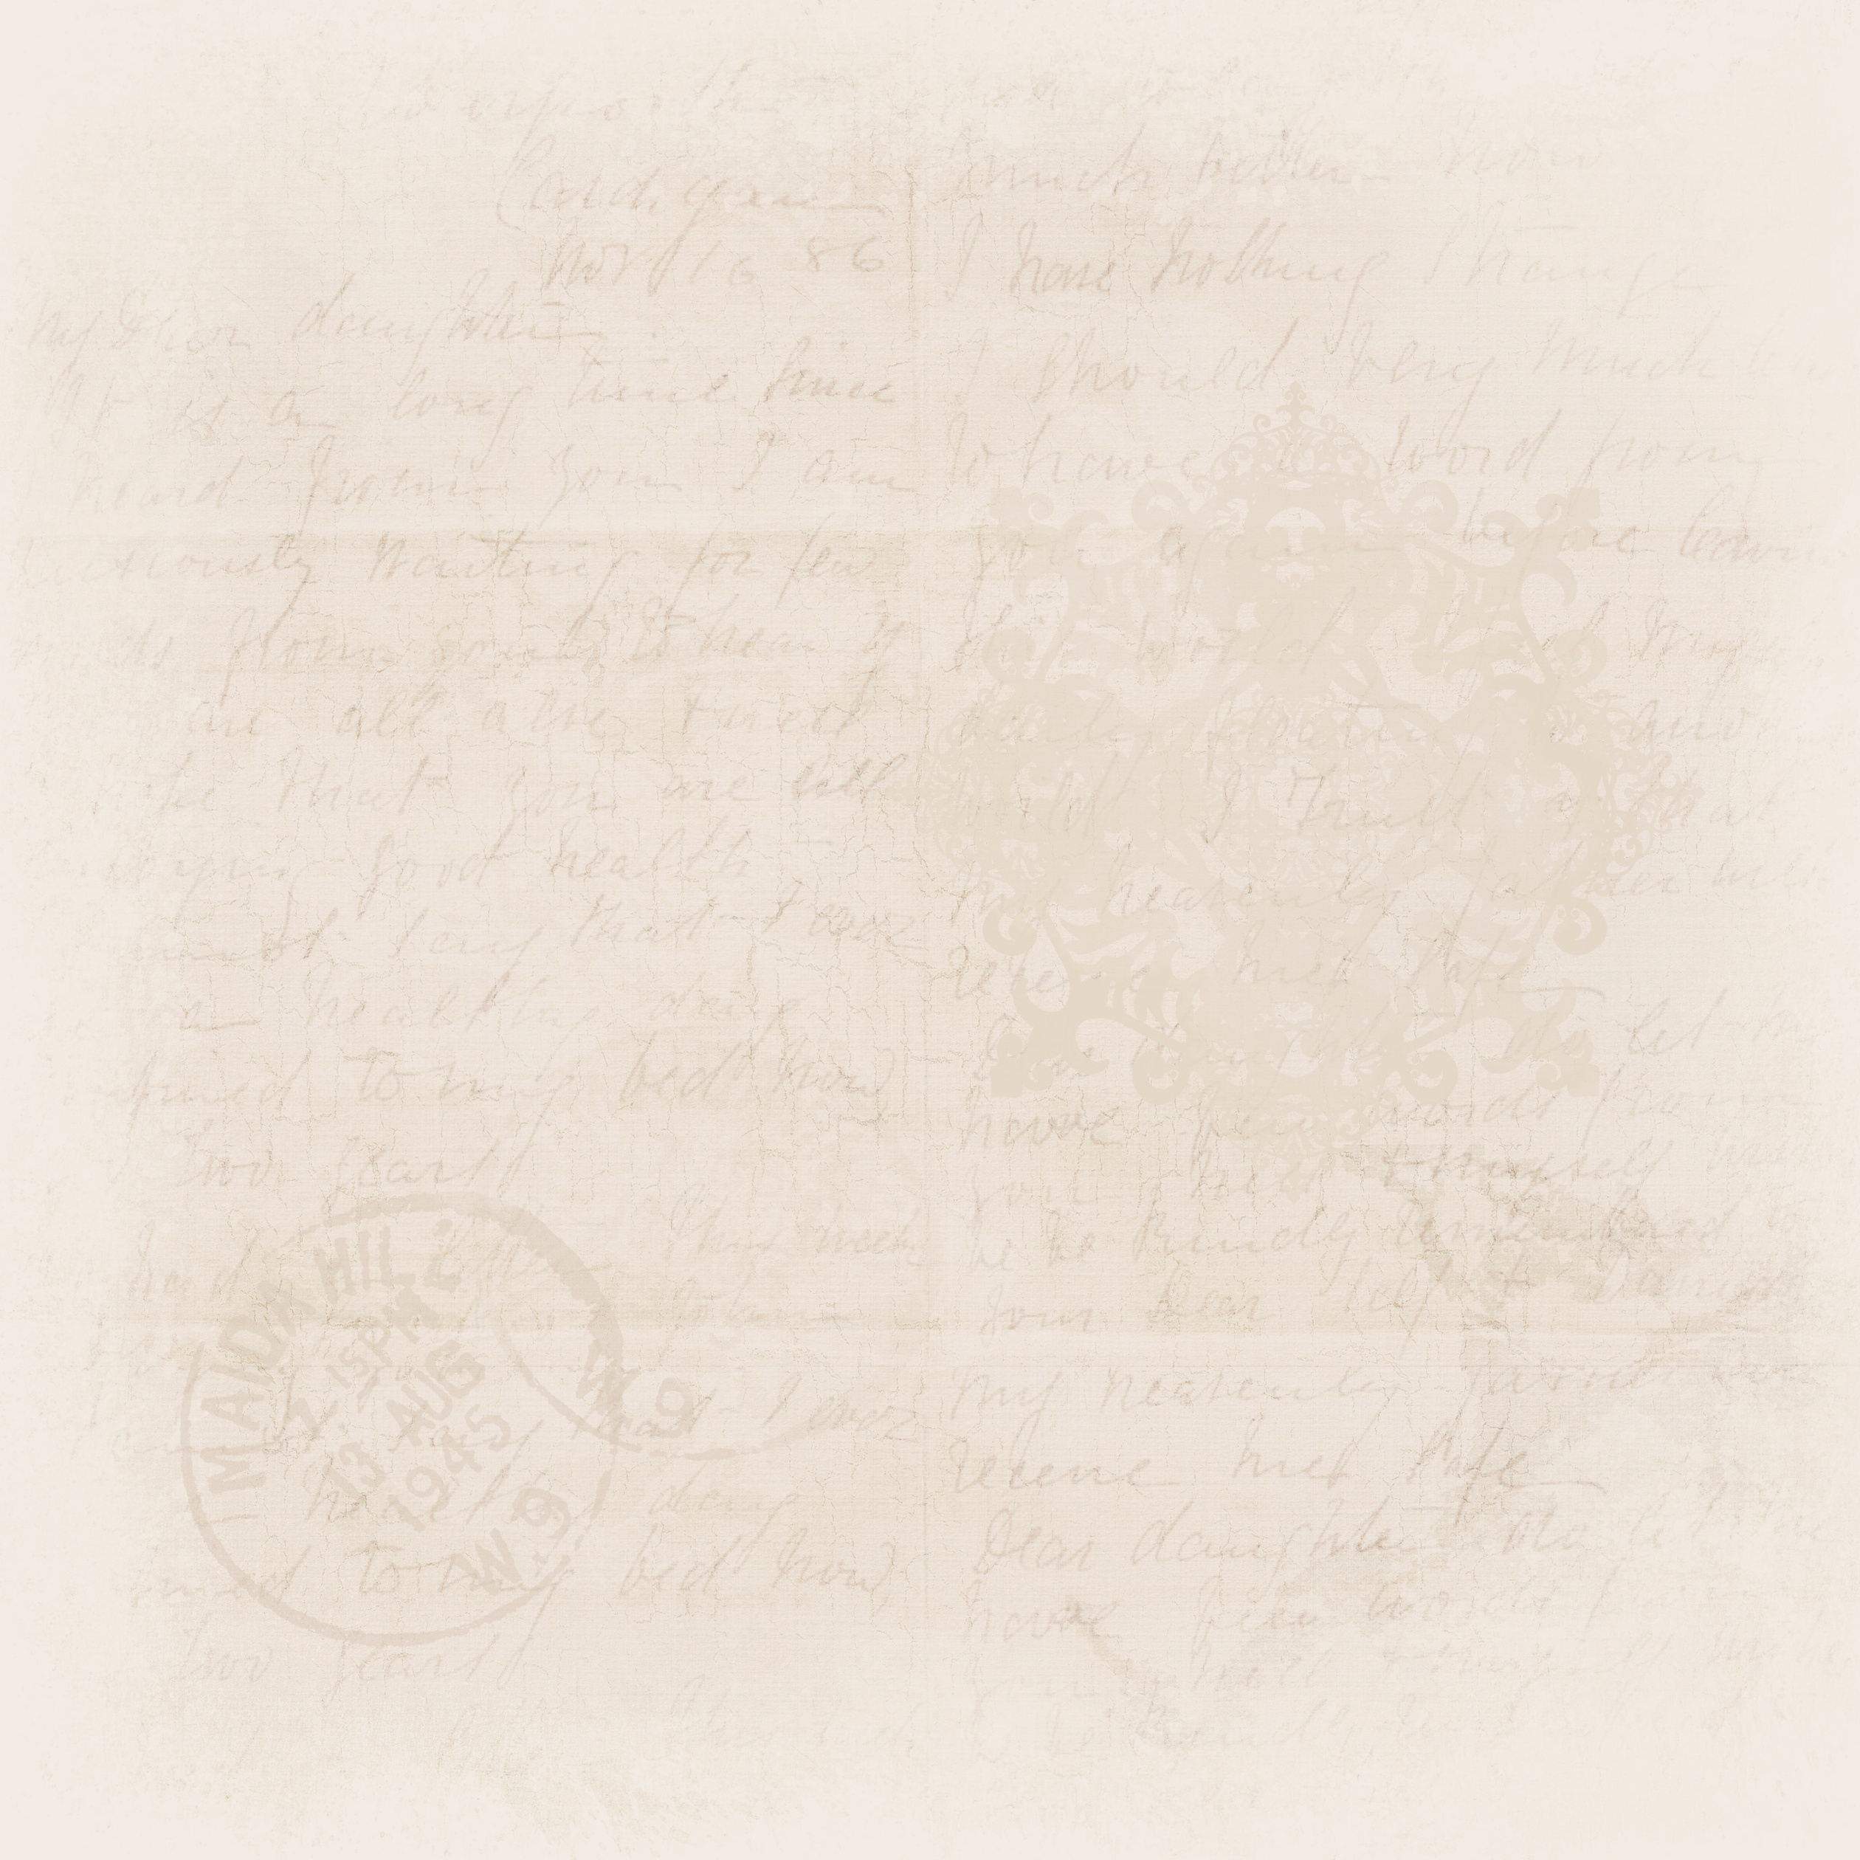



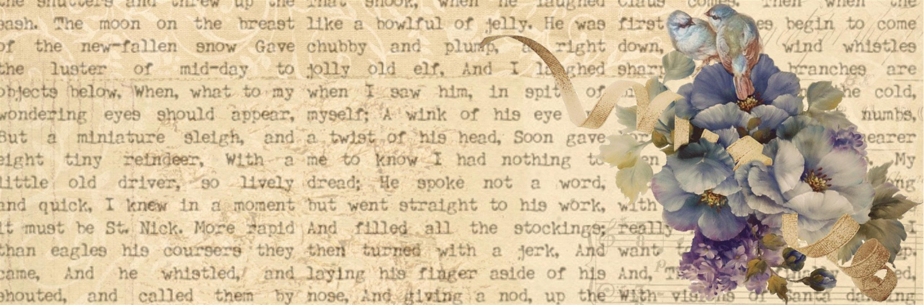





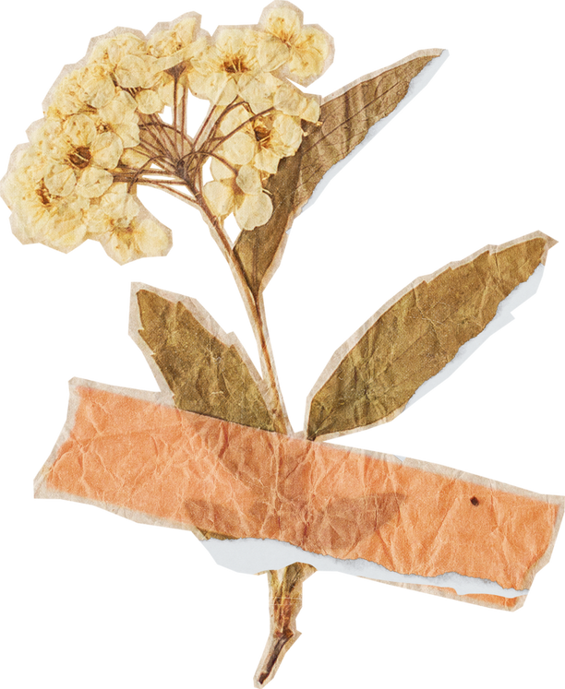
The First Philippine Republic

Slide 2
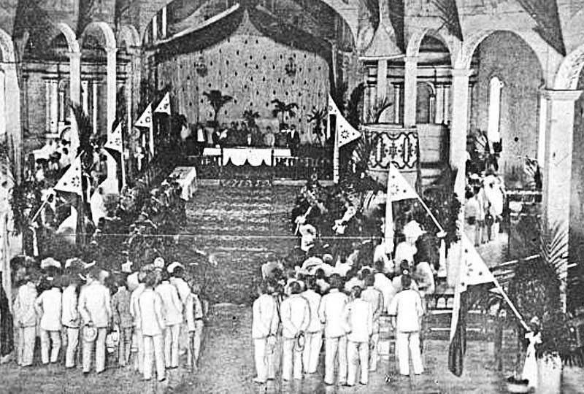
The First Philippine Republic, also known as the Malolos Republic, was established on January 23, 1899, after the Philippines declared independence from Spanish colonial rule and during the early stages of the Philippine-American War. Here are some aspects of everyday life and culture during that time:

Slide 3
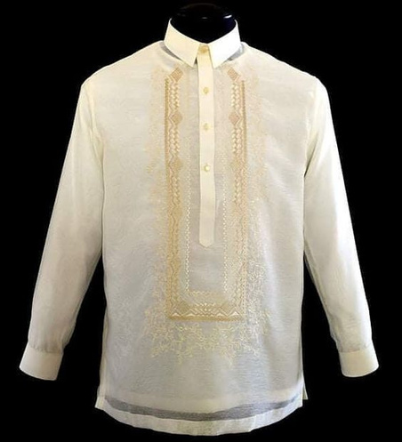
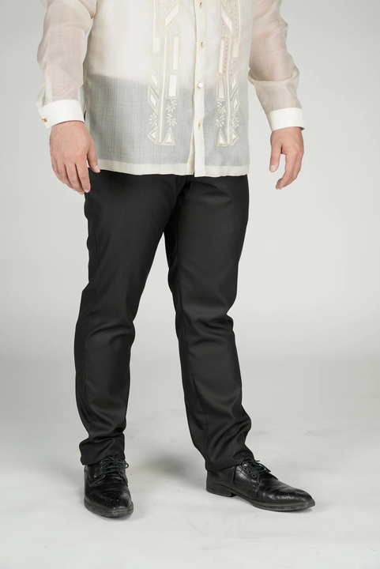
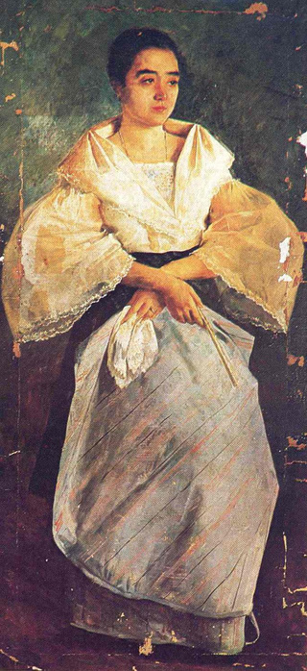
Traditional Clothing
Filipino attire during this period was heavily influenced by Spanish fashion. Men typically wore barongs or camisas (loose-fitting shirts) paired with trousers called pantalon. Women wore baro't saya, which consisted of a blouse (baro) and a long skirt (saya).
Baro’t saya
Barong Tagalog
Pantalon/Trousers

Slide 4
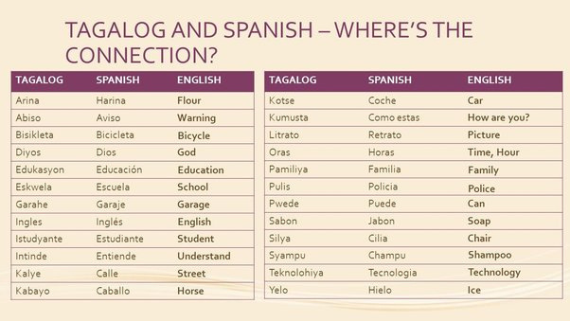
Language and Literature
Tagalog was the predominant language, but Spanish was also widely spoken, especially among the educated class. Filipino literature flourished during this time, with notable writers such as Jose Rizal and Andres Bonifacio producing works that reflected the spirit of independence and national identity.

Slide 5
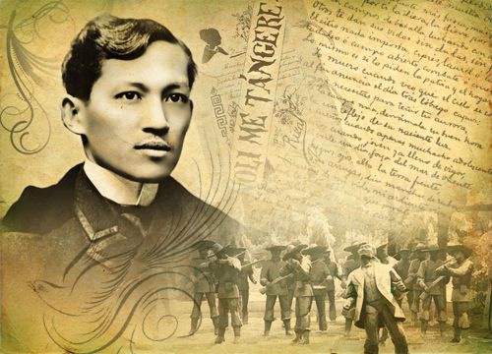
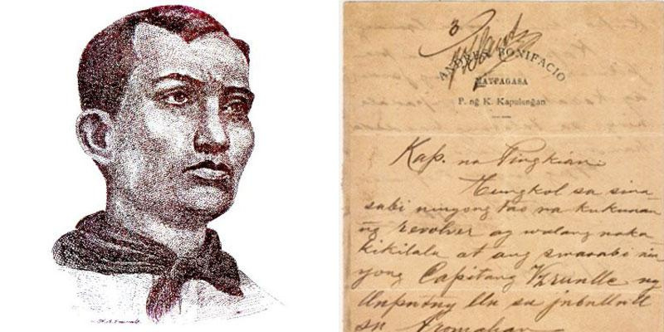

Slide 6
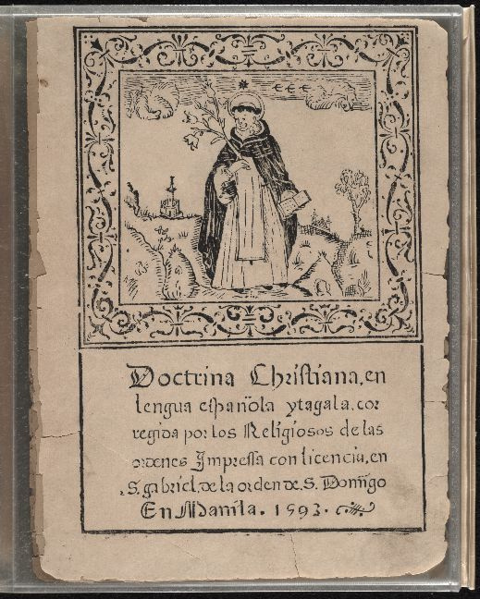
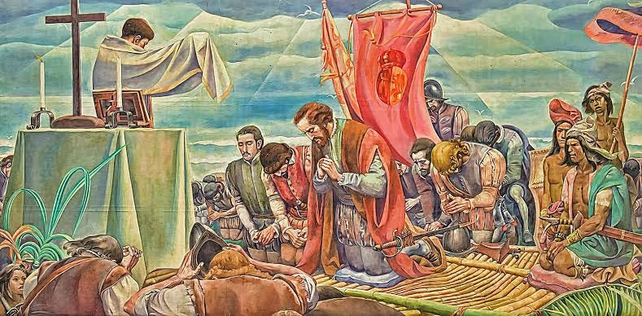
Religion
The majority of Filipinos were Catholic due to centuries of Spanish colonization. Catholicism played a significant role in shaping daily life, customs, and traditions.

Slide 7

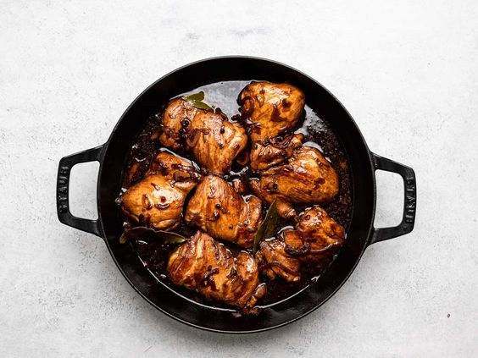
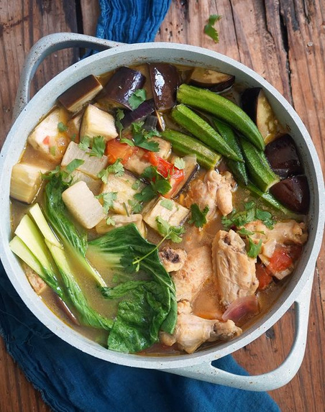
Food and Cuisine
Traditional Filipino cuisine was prevalent, consisting of dishes such as adobo (marinated meat), sinigang (sour soup), and various seafood dishes. Rice was a staple food, often served with every meal.
Adobo
Sinigang
Rice

Slide 8
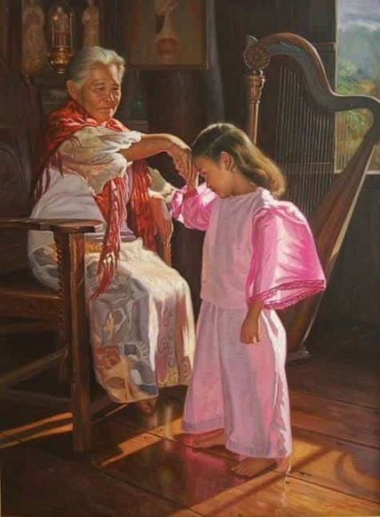
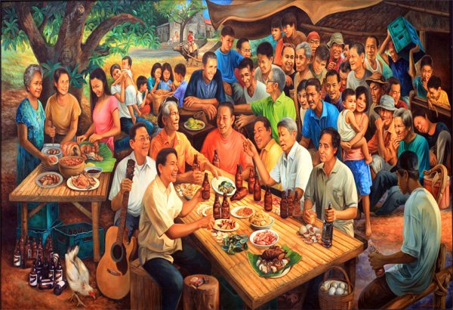
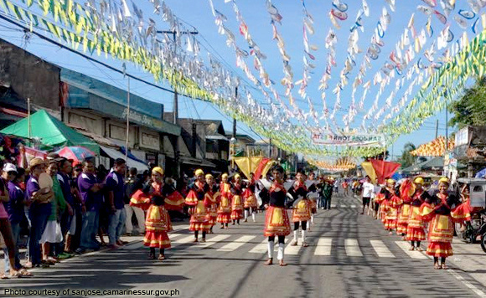
Family and Social Structure
Filipino society was largely patriarchal, with families being tightly-knit and extended. Respect for elders and strong family ties were emphasized. Social gatherings and celebrations, such as fiestas, were common and served as opportunities for community bonding.
Fiesta

Slide 9
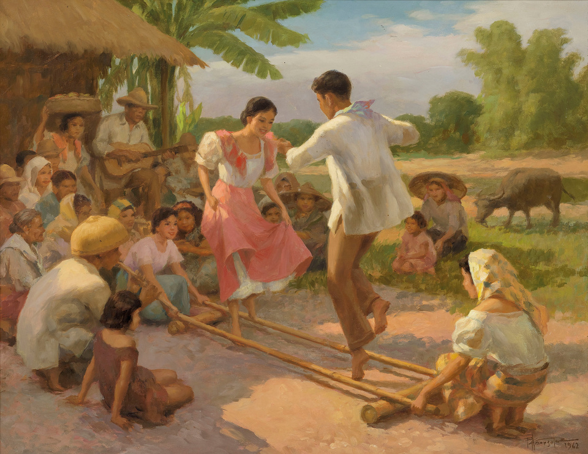
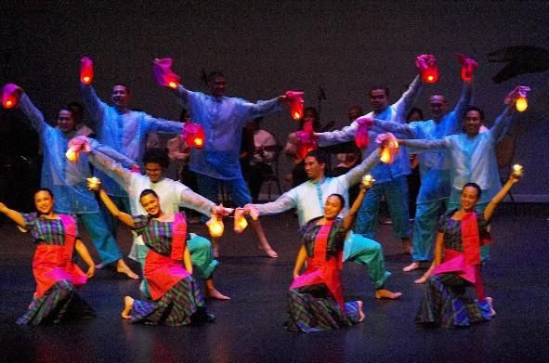
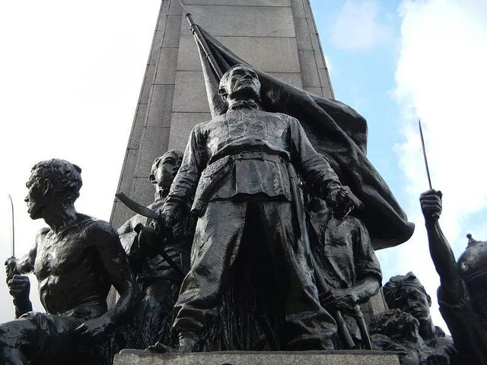
Arts and Entertainment
Traditional Filipino arts, such as music, dance, and visual arts, thrived during this period. Folk dances like Tinikling and Pandanggo sa Ilaw were popular forms of entertainment, often performed during celebrations and gatherings.
Bonifacio Monument -
Guillermo Tolentino
Pandango sa Ilaw
Tinikling (1962) - Fernando Amorsolo

Slide 10
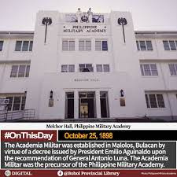
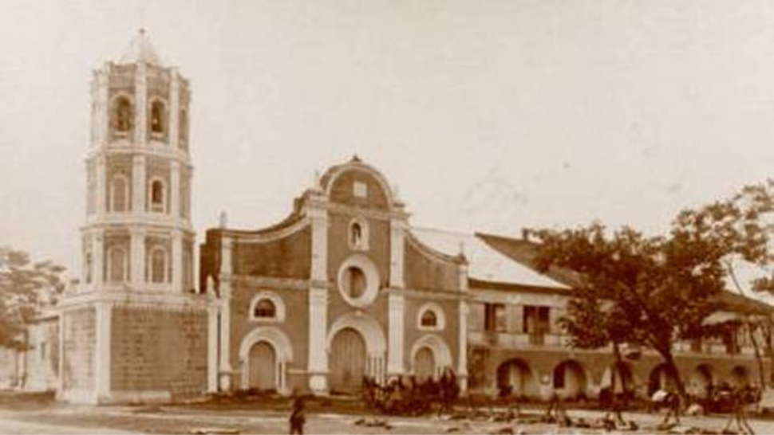
Education
The establishment of schools and educational institutions became a priority for the First Philippine Republic. Education was seen as crucial for national development and the preservation of Filipino identity.
Universidad Literaria de Filipinas, the First Filipino University
Academia Militar

Slide 11
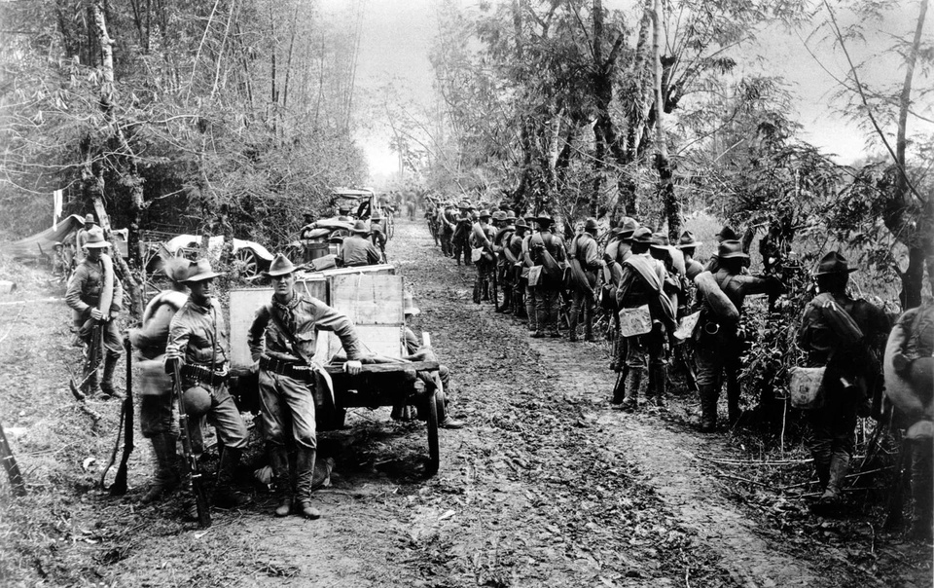
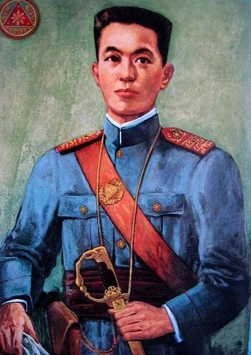
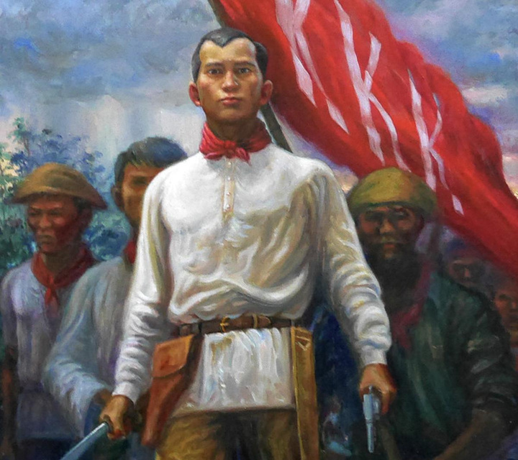
Resistance and Independence
Despite the challenges posed by the Philippine-American War, there was a strong sense of nationalism and resistance against foreign occupation. Filipinos fought bravely for their independence, inspired by leaders such as Emilio Aguinaldo and Andres Bonifacio.
Philippine-American War
Andres Bonifacio
Emilio Aguinaldo

